Slide 1

Assalamualikum
Name :Afrin
Roll: 001
Topic: Coffee maker

Slide 2
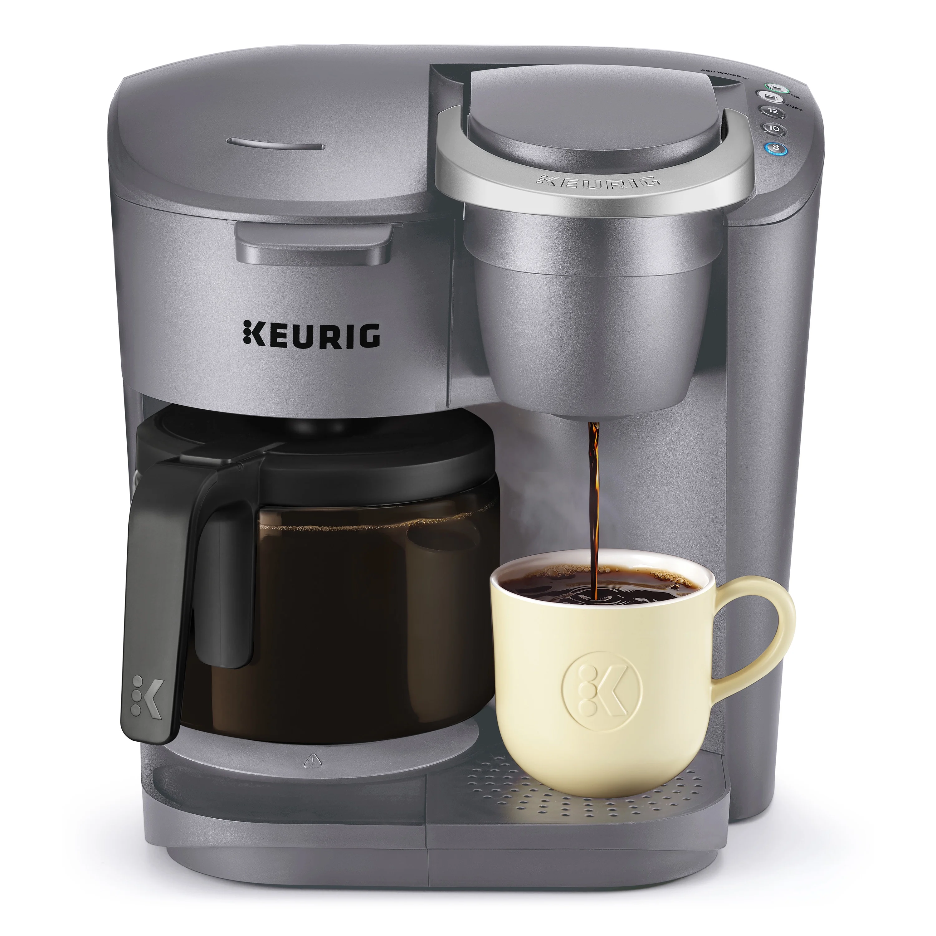
What is Coffee maker?
A coffeemaker, coffee maker or coffee machine is a cooking appliance used to brew coffee. While there are many different types of coffeemakers, the two most common brewing principles use gravity or pressure to move hot water through coffee grounds.hat is coffee maker?
Figure: A Coffee Maker

Slide 3
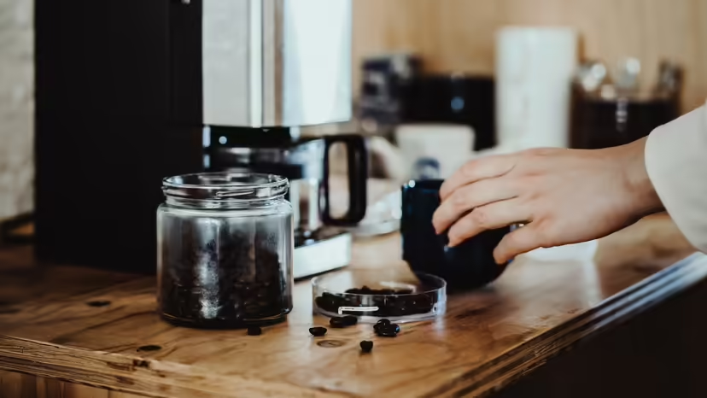
How coffee maker work?
When you pour in cold water, it flows from the reservoir through the hole and into the orange tube.
Then the water flows through the one-way valve, into the aluminum tube in the heating element and then partially up through the white tube. This all happens naturally because of gravity.
­When you turn on the switch, the resistive heating element starts heating the aluminum tube and eventually the water in the tube boils.
When the water boils, the bubbles rise up in the white tube. What happens next is exactly what happens in a typical aquarium filter: The tube is small enough and the bubbles are big enough that a column of water can ride upward on top of the bubbles.
The water flows up the white tube and is dispersed to drip evenly on the waiting coffee grounds.
The hot water flows through the ground coffee beans, picking up their oil essence on the way down into the coffee pot. This coffee oil, released during the roasting process, is called caffeol.w coffee maker work?

Slide 4
Drip Coffee Maker Problems: What Can Go Wrong with Your Coffee Maker?
Here are some of the most common problems that can cause your drip coffee maker to stop working:­
The power cord or on/off switch can go bad. In either of these cases, it's best to get a pro to replace it or buy a new coffee maker -- replacing it improperly can lead to a fire.
The one-way valve can get clogged open or closed. You can usually fish out the debris that causes this problem with a toothpick.
The tubes can get clogged with calcium. This is especially true of the aluminum heating tube. The normal way to solve this problem is to run vinegar through the machine once, and then run two batches of water through to clean out the vinegar.

Slide 5
How to Use a Coffee Maker
Add water One of the first steps to use a coffee maker is to fill the machine with water. ...
Put the filter inside ...
Grind the beans and add the coffee to the basket ...
Brew your coffee ...
Turn off the machine, pour and enjoy ...
Do not forget to clean the coffee maker ...
Ending ...

Slide 6
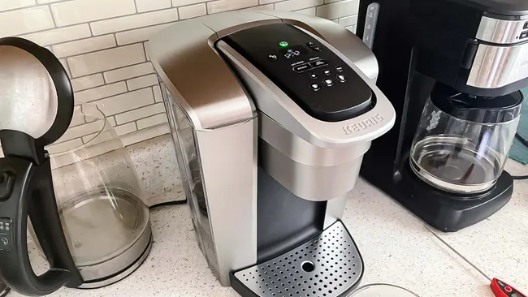
The Best Coffee Makers, Based On Testing 30-Plus Top Mode
A good coffee maker is a kitchen workhorse, designed to yield flavorful, full-bodied cups of joe. Over the past year-plus, we set out to determine the very best coffee makers by putting more than 30 models to the test. Based on rigorous testing, the OXO Brew 9-Cup is the top option overall, thanks to its premium features and smooth brew at a reasonable price point. But if you’re looking for a more affordable option, the under-$100 Ninja 12-Cup Programmable Brewer also impressed us by offering features and brew quality on par with more expensive machines.

Slide 7
Impacts of coffee maker in modern era
acts as a social lubricant
community bonding
breaking the ice between individuals
Impacts
social interactions
social movements
enthusiasts actively seek out ethically

Slide 8
Cost
A
effect
B
loss
C
impact
D

Slide 9

THANKS

